Slide 1
System Software Crash Course
Block E: Version Control Systems
Sergey Ignatov

Slide 2
Version Control System (VCS)
Version Control System (VCS) or Source Control Management (SCM) is a system for managing multiple revisions (versions) of the same unit of information.
Version Control Systems most commonly run as stand-alone applications, but revision control is also embedded in various types of software such as word processors, spreadsheets, collaborative web docs and in various content management systems (Wikipedia page history).
VCS allow multiply developers (in remote locations) to work on the same code base.
There are two main categories of version control systems:
Centralized version control systems
Distributed version control systems
(© S.Ignatov, 2018

Slide 3
Why Version Control System (VCS)
Backup and Restore Project components are saved as they are edit, and an user can extract them at any time.
Synchronization (collaboration) People can share project components and stay up-to-date with the latest version.
Short-term & long-term undo People can go back to the “latest known good” version or to the “version with the bug” in the database.
Track changes & ownership People can easily see how a file is evolving over time, why and whom.
Sandboxing Isolating temporary changes in a separated branch, working and testing over it.
Branching & Merging A larger sandbox for a long-term development with merging the final version into the project database.
Forking Developing and maintaining more copies of main project for creating some specific versions.
(© S.Ignatov, 2018

Slide 4
Centralized Version Control System
Traditional Version Control System (VCS)
A single server holds the code base.
Clients access the server by means of check-ins/check-outs operations.
Examples: CVS, Subversion, Visual Source Safe
Advantages: Easier to maintain a single server.
Challenges:
Multi-developer conflicts
Client/server communitcations
(© S.Ignatov, 2018

Slide 5
Distributed Version Control System
Each client (essentially) holds a complete copy of the code base
Code is shared between clients by push/pull operations
Authoritative server by convention only
Every working checkout is a repository
Get version control even when detached
Backups are trivial
Disadvantage: a bit more compilcated
Examples: Git, Mercurial, BitKeeper, Darcs, Bazaar
(© S.Ignatov, 2018

Slide 6
Centralized vs Distributed
Centralized VCS focuses on synchronizing, tracking and backing up files
Synchronous
unique reference
fixed hierarchy
Centralized access control
Simpler
Distributed VCS focuses on sharing changes, every change has an unique identifier
Asynchronous
copy = repository
loose hierarchy
Offline:
History
Commits
Branches
More powerful
(© S.Ignatov, 2018

Slide 7
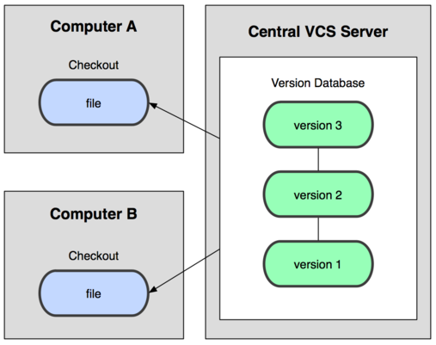
Centralized VCS
(© S.Ignatov, 2018

Slide 8
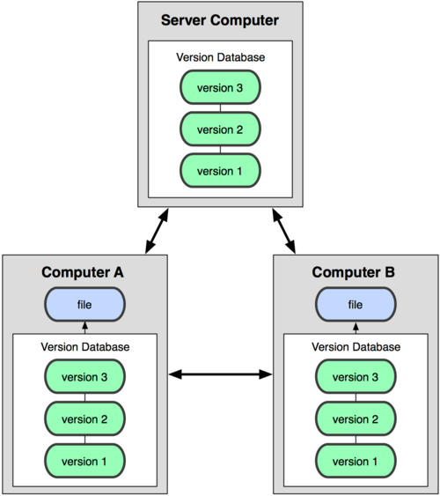
Distributed VCS
(© S.Ignatov, 2018

Slide 9
VCS Terminology – Basic Setup
Repository(repo) The database storing the project components (files etc).
Server The computer storing the repo.
Client The computer connecting to the repo.
Working Set/Woring Copy User’s local copy of files, where the person make changes.
Trunk/Main The primary location for code in the repo, main line of code base.
(© S.Ignatov, 2018

Slide 10
VCS Terminology – Basic Actions
Add Putting a file into the repo for the first time, i.e. begin tracking it with VCS.
Revision Version of a file with version’s identifier.
Head The latest revision in the repo.
Check out Download a file from the repo.
Check in Upload a file to the repository (if it has changed). The file gets a new revision number.
Checkin Message A short messaged describing what was changed.
(© S.Ignatov, 2018

Slide 11
VCS Terminology – Basic Actions
Changelog/History A list of changes made to a file since it was added.
Update/Sync Synchronizing user’s files with the latest from the repository.
Revert Throwing away user’s local changes and reloading the latest version from the repository.
Push Sending changes to another repository (may require permission)
Pull Grabbing changes from a repository
(© S.Ignatov, 2018

Slide 12
VCS Terminology – Advanced Actions
Branch Creating a separate copy of a file/folder for private use (bug fixing, testing, etc. Branch is both a verb (“branch the code”) and a noun (“which branch is it in?”).
Diff/Change/Delta Finding the differences between two files. Useful for seeng what changed between revisions.
Merge (patch) Applying the changes from one file to another, to bring it up-to-date.
Conflict When pending changes to a file contradict each other (both changes cannot be applied).
(© S.Ignatov, 2018

Slide 13
VCS Terminology – Advanced Actions
Resolve Fixing the changes that contradict each other and checking in the correct version
Locking Taking control of a file so nobody else can edit it until user unlocks it. Some VCS use this to avoid confilcts.
Breaking the lock Forcibly unlocking a file so user can edit it. It may be needed if someone locks a file and doesn’t edit it for a while.
Check out for edit Checking out an “editable” version of a file. Some VCSes have editable files by default, others require an explicit command.
(© S.Ignatov, 2018

Slide 14
VCS Typical Scenario
One user adds a file to the repository.
This user checks it out, makes a change and check it back in with a checking message.
Some other user updates (her)his local working set and sees the latest revision of the new file.
(S)he can browse the changelog or diff
(© S.Ignatov, 2018

Slide 15
Git VCS
A collection of tools developed by Linux kernel group for SCM
Now used by many other groups, and apparently growing in popularity.
First prototype was created by Linus Torvalds (creator and principal developer of Linux kernel) on April 7, 2005
Actually implements a replicated versioned file system.
Can be used to implement a variety of software configuration management models and workflows.
(© S.Ignatov, 2018

Slide 16
Git Flavor
A distributed version control system.
A collection of many command-line tools.
Evolved from scripts.
Suited to a C/C++ programmer’s mentality.
Everything is exposed and accessible.
Very flexible: An user can do anything the model permits.
Need to understand the underlying model
A proper and detailed understanding of Git will allow to make a transition to any other DVCS
(© S.Ignatov, 2018

Slide 17
Git vs Other DVCS
+ Fast, scalable (execution and setup).
+ Powerful small tools (Unix spirit).
+ Lively development.
+ Smart design.
- Learning curve (user should grasp concept)
- Imperfect on MS Windows
- No library
(© S.Ignatov, 2018

Slide 18
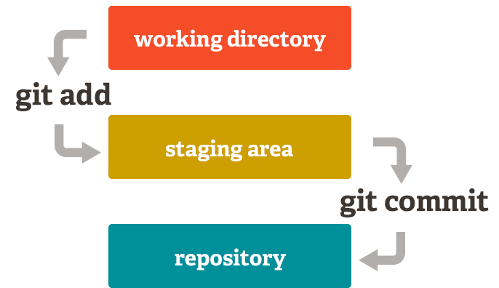
Basic Git Model Locally
(© S.Ignatov, 2018

Slide 19
Basic Git Model Locally
In an user’s local copy on git repository, files can be:
In user’s local repo - commited.
Checked out and modified, but not yet commited – working copy.
Or, in-between, in a a “staging” area – staged files are ready to be commited.
A commit saves a snapshot of all staged state.
(© S.Ignatov, 2018

Slide 20
Basic Git Model Locally
In Git, each user has own copy of the repo and commited to their local copy of the repo before pushing to the central server.
So Git generates a unique SHA-1 hash (40 character string of hex digits) for every commit.
Refers to commits by this ID rather than a version number in other VCSes.
(© S.Ignatov, 2018

Slide 21
Git Commands
Git has a many commands.
Groups of Git commands:
Setup and branch management: init, checkout, branch
Modify: add, delete, rename, commit
Get information: status, diff, log
Create reference points: tag, branch
(© S.Ignatov, 2018

Slide 22
Basic Git Commands
git init initialize a git repository/working directory
git status status of your working directory
git add <filename> or git add . (for all files in user’s working directory)
git commit stash changes in user’s working directory
git commit –oneline view user’s commit history
git clone create an identical copy
(© S.Ignatov, 2018

Slide 23
More Git Commands
git push push user’s changes into the remote repository
git pull pull user’s latest changes from the remote repository
git branch view branches in user’s repository
git branch <branchname> create a branch
git checkout <branchname> move to the branch
git merge <branchname> merge into the branch
git revert revert some existing commits
(© S.Ignatov, 2018

Slide 24
Two Common Git Scenarios
To create a new local Git repo in the current directory:
git init
This will create .git directory in the current directory
Then an user can commit files in that directory into the repo
git add filename
git commit –m “commit message”
To clone a remote repo in the current directory:
git clone url localDirectoryName
This will create the given local directory, containing a working directory, the files from the repo, and a .git directory (used to hold the staging area and user’s actual local repo).
To push committed changes to a remote repo:
git push
(© S.Ignatov, 2018

Slide 25
Useful Git Info Commands
Checking working directory status:
git status
Reports files in the working directoyr that are not traked
Reports file modifications not yet staged for commit
Reports file addtions and modifications staged for commit
Overview commit history:
git log
Lists commits made to the current directory
Shows changes:
git diff – not yet staged for commit
git diff <commit_id> – since the commit specified
git diff <commit_id1> <commit_id2> – between two commits
(© S.Ignatov, 2018

Slide 26
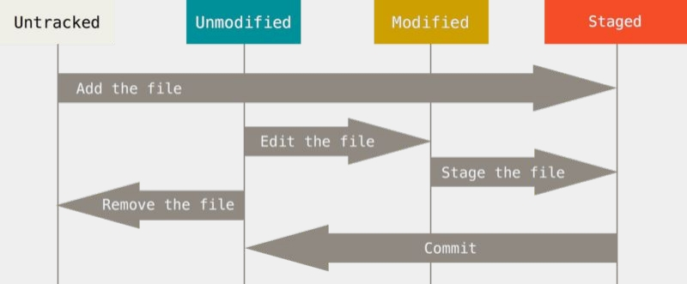
Lifecycle of a File in Git
(© S.Ignatov, 2018

Slide 27
Git Branching and Merging
Git uses branching heavily to switch between multiple tasks.
To create a new local branch:
git branch <branch_name>
To list all local branches:
git branch
To switch to a given local branch:
git checkout <branch_name>
To merge changes from a branch into the local master:
git checkout master
git merge <branch_name>
(© S.Ignatov, 2018

Slide 28
Git Interaction With Remote Repo
Push local changes to the remote repo.
Pull from the remote repo to get the most recent changes (fix conflicts if necessary, add/commit them to the local rep).
To fetch the most recent updates from the remote repo into the local repo, and put them into the working directory:
git pull origin master
To put the changes from the local repo in the remote repo:
git push origin master
git merge <branch_name>
(© S.Ignatov, 2018

Slide 29
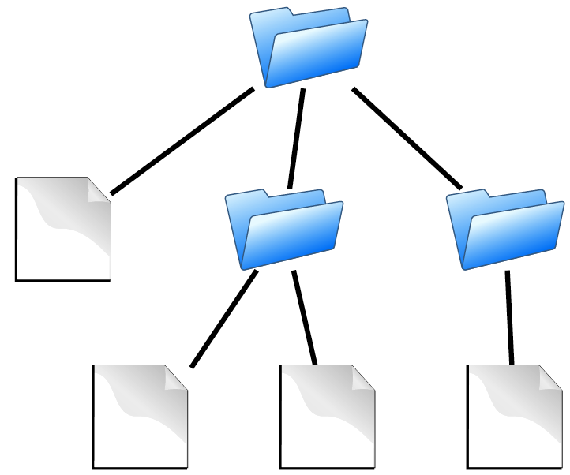
Git Structure: Source Code
Source code
contains
Directories
Files
is the substance of a software configuration
(© S.Ignatov, 2018

Slide 30
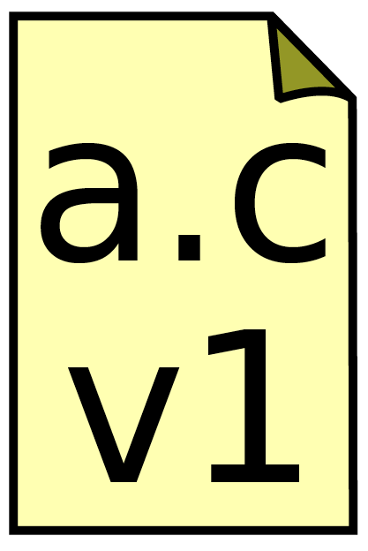
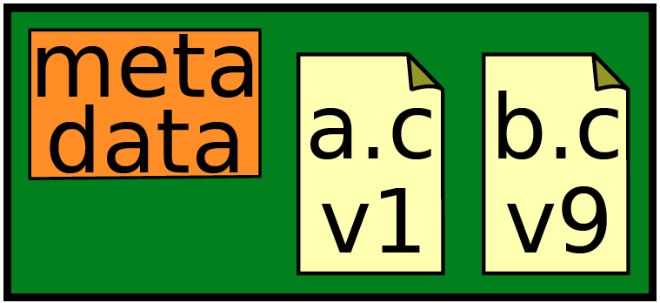
Git Structure: Repository
Repository = Object Database
Id(object) = SHA 1(object content)
contains
Files (BLOB –Binary Large Object)
Commits (Object)
(© S.Ignatov, 2018

Slide 31
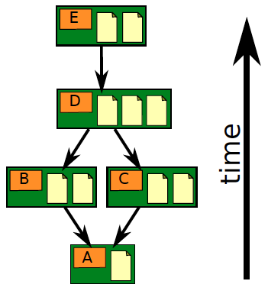
Git Structure: Repository
Repository
contains
Files
Commits
Ancestry relationships
(© S.Ignatov, 2018

Slide 32
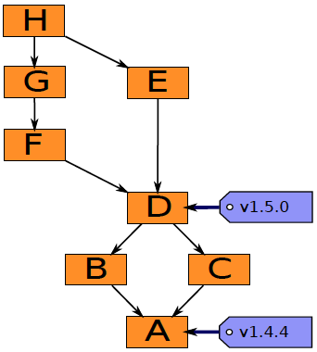
Git Structure: Repository
Repository
contains
Ancestry relationships
forms a directed acyclic graph (DAG) = Tree Object
(© S.Ignatov, 2018

Slide 33
Git Structure: Repository
Repository
Ancestry graph features:
Tags (objects)
- identify versions of interest
- including “releases”
(© S.Ignatov, 2018

Slide 34
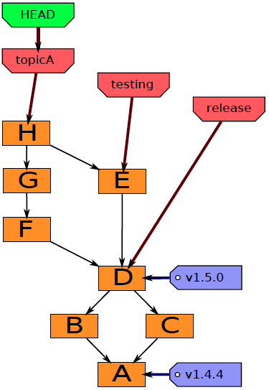
Git Structure: Repository
Repository
Ancestry graph features:
HEAD
- is current checkout
- usually points to a branch
(© S.Ignatov, 2018

Slide 35
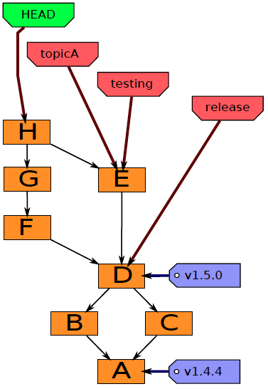
Git Structure: Repository
Repository
Ancestry graph features:
HEAD may point to any commit
- in this case it is said to be detached
(© S.Ignatov, 2018

Slide 36
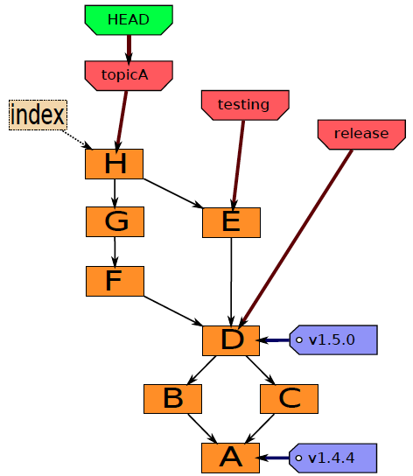
Git Structure: Repository
Git components
Index
- “staging area”
- what is to be commited
(© S.Ignatov, 2018

Slide 37
GitHub = Git Social Network
It’s a hosting medium/website for your Git repositories.
Offers powerful collaborative abilities.
A good indicator of what you
code
how much you code
quality of your code
It’s the place where your code is stored. By default, remote name is origin and default branch name is origin.
Access it on github.com – create an account if you don’t already have one.
(© S.Ignatov, 2018

Slide 38
GitHub Important Concepts
Creating a repo – Creating a repository for multiple people to work together.
Master in a repository – This is the final version that is considered ready to use by anybody in the team or outside if repository is public.
Creating a branch
Create a branch in your project, for an environment where you can try out new ideas.
Changes you make on a branch don’t affect the master unless pull request is accepted.
Changes committed to branch reflects for you to keep track of different versions.
Adding commits
Keeps track of your progress as you work on a branch or master
Creates a transparent history that others can follow to understand what you’ve done and why.
(© S.Ignatov, 2018

Slide 39
GitHub Important Concepts
Forking a repository
It creates a copy for you to work on independently without any changes to theirs.
Submit a pull request to owner so that the owner can incorporate changes.
Pull requests
Pull requests initiates discussion about your commits or changes made to a code.
See exactly what changes would be merged if pull request is accepted.
Use GitHub’s @mention system in your pull request message to ask for feedback form specific people or teams, or for someone to review your work.
Issues
Highlight bugs or issues with codes that need rectification.
Issues remain open unless resolved.
Can be filtered. Can be labeled as bug/enhancement/question/help wanted etc.
@mention can be used to notify someone.
(© S.Ignatov, 2018

Slide 40
GitHub Important Concepts
Markdown syntax
Markdown is a way to style text on the web.
Available in description and comments of Issues and Pull Requests. These include @mentions as well as references to SHA-1 hashes, Issues, and Pull Requests.
Watch and Star
Watch notifies us of all conversations over and above your @mentions, commits, comments on discussion. Star will favorite it but not show on your dashboards like watch.
(© S.Ignatov, 2018

Slide 41
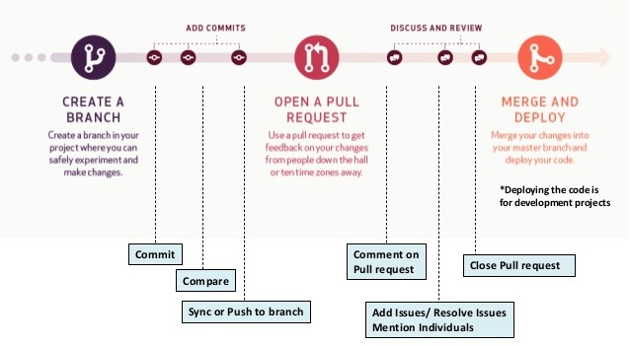
GitHub Workflow
(© S.Ignatov, 2018

